Slide 1
Regression Analysis
Murthi
2019

Slide 2
Multiple regression
Fitting a linear model to find a relation between a
dependent variable (Y) and
a number of independent (or explanatory) variables (X_{i}).
What factors affect sales of our product?
Y=sales
X_{i} = price, advertising, brand, promotions etc.

Slide 3
Example
SALES | the number of liquid ounces sold for a UPC (per week and store)
PRICE | the price per liquid ounce for a UPC (per week and store)
DEAL | indicator/dummy of whether a UPC was price-promoted that week (takes on 0 or 1)
FEAT | indicator of whether UPC was advertised or on in-store display that week (takes on 0 or 1)
HVAL150 | the percentage of real estate property in the so-called store trading area (i.e., the store neighborhood) whose value exceeds $150,000
NUMCOMP | the number of competitors
CLASS | 1= regular versus 0= diet soft drink

Slide 4
SAS Regression output
Dependent Variable: SALES
Number of Observations Read 1640
Number of Observations Used 1640
Analysis of Variance
Sum of Mean
Source DF Squares Square F Value Pr > F
Model 7 29523558600 4217651229 111.88 <.0001
Error 1632 61522897048 37697854
Corrected Total 1639 91046455648
Root MSE 6139.85778 R-Square 0.3243
Dependent Mean 3286.71220 Adj R-Sq 0.3214
Coeff Var 186.80850

Slide 5
Parameter Estimates
Parameter Standard
Variable Estimate Error t Value Pr > |t|
Intercept 6834.17 2177.93790 3.14 0.0017
PRICE -170964 80633 -2.12 0.0341
DEAL 11894 5006.64513 2.38 0.0176
FEAT 10416 895.24188 11.64 <.0001
HVAL150 1266.09 1171.46147 1.08 0.2800
NUMCOMP -37.15 37.45954 -0.99 0.3214
CLASS1 722.50 312.76359 2.31 0.0210

Slide 6
Modeling Interactions
Interaction: additional effect if two X variables are present and they generate a synergistic (or a cancellation) effect
E.g.,
coupon increases sales by 10.
Ad increases sales by 5
If both coupon and ad are used, we expect to get an increase in sales = 15
But if sales are 20, then there is an additional 5 sales that is called synergy.
Similarly, if (in another situation) the sales are 12 there is a cancelation effect of 3.

Slide 7
How to test for interaction effects
Y = a +b*price +c* ad
If we wish to test interaction between lowering price and advertising the low price include an additional term that is the product of the two variables
Y = a - 3*price + 0.05* ad + d*price* ad
If d is significant, there is an interaction effect
If d is negative, there is synergy
If d is positive there is cancellation.

Slide 8
Non-linearity
Some variables may not have a linear effect of the dependent variable. How will you test for non-linear effects?

Slide 9
Y = a +b*ad +c* ad²
Y=aPrice^{b} Ad^{c}

Slide 10
Influence statistics
COOK’s D > 3*average
DFFITS change in predicted value for i^{th} obs > 2 √p/n
DFBETAS change in parameter estimate > 2/√n
COVRATIO ⎢cov ratio -1⎢ ≥ 3p/n

Slide 11
Multicollinearity (MC)
X₁ is related to X₂ or X₃
Highly correlated or
Linearly dependent
So what happens?
Estimated variances of β become large => low t values => do not reject null hypotheses.
Signs of coefficients could be incorrect.
Results are sensitive to deletion of a single row.

Slide 12
Sources of multicollinearity
1. High correlations between independent variables (X_{i}) are one source of collinearity
2. Absence of high correlation does not imply there is no problem of collinearity.
Multicollinearity can also occur if an independent variable can be expressed as the weighted sum of other independent variables.

Slide 13
How to detect if there is MC?
1. Check all pairwise correlations between the independent variables.
2. Look at VIF (variance inflation factor).
VIF=1/(1-r_{2,3} ²)
If VIF is greater than 10 there could be multicollinearity
3. Use COLLIN option in PROC REG. Multicollinearity is present if
The condition index is high (more than 100) and
Two or more variables have a high proportion of variance

Slide 14
Solutions
Delete one of the two correlated independent variables
Combine the two correlated variables.
Use principal components
Use ridge regression, LASSO (least absolute shrinkage and selection operator), elastic nets (called regularization)

Slide 15
Heteroscedasticity
We assume that the variances of the error term are constant across all observations.
Sometimes, this is not true.
E.g., variance in sales of large firms may be larger than that of small firms.
As people learn their error rates (and its variance) decrease.

Slide 16
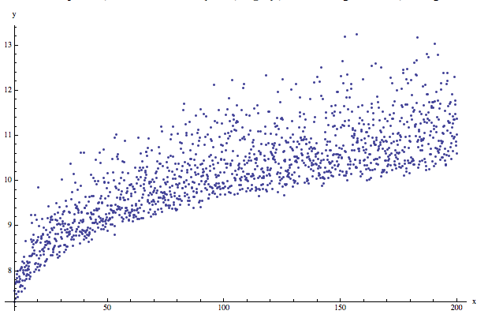
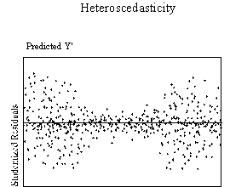
Heteroscedasticity - detection
Plot standardized residuals against predicted Y.
If the variance of the residuals increases or decreases with a corresponding increase in predicted Y then there is heteroscedasticity

Slide 17
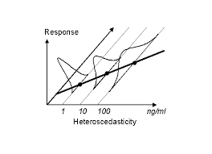
Tests
White test
Breusch Pagan test
Goldfeld-Quandt test

Slide 18
Solutions
Transform the Y variable using a log function or a square root function to mitigate the problem.
That is, use log(Y) or sqrt(Y) as dependent variable.
Use weighted least squares (WLS) method
Here we weight each observation by an X variable
OLS Y = a + b*X₁+ c* X₂ + ε
WLS Y/X₁ = a/X₁ + b + c * X₂/X₁+ ε₁

Slide 19
PROC REG
PROC REG options;
Options are:
DATA= name names SAS dataset to be used
OUTEST = name puts parameter estimates in this dataset
NOPRINT suppresses printed output
SIMPLE prints simple descriptive statistics for each variable

Slide 20
PROC REG
MODEL Y= X₁ X₂ / options;
Options are:
NOPRINT suppresses printed output
NOINT No intercept term in the model
STB prints standardized regression coefficients
TOL Prints tolerance values (=1-R²)
VIF prints variance inflation factors (= 1/ TOL)
COLLIN Tests for collinearity
PCORR1 prints partial correlation coefficients
P calculates predicted values
R calculates residuals
CLM prints 95% confidence limits for the Y predicted
DW calculates Durbin Watson statistic
INFLUENCE analysis of influence of each observation
TEST equation1 tests hypotheses
TEST B1=0
TEST A1+A2=1
MTEST multivariate tests

Slide 21
PROC REG
WEIGHT variable;
Used to name the variable that is used to weight the observations in weighted least squares (WLS) estimation.
OUTPUT OUT=SASdataset P=names R=names;
BY variable;

Slide 22
VIF, STB, White
data a1;infile 'C:\mfund.dat' firstobs=3;
input share return ratings beta expense time size;run;
proc reg;
model share=return ratings beta expense time size/vif stb;
run;
proc model data=a1;
parms b0 b1 b2 b3 b4 b5 b6;
share=b0+b1*return+ b2*ratings+ b3*beta+ b4*expense+ b5*time+ b6*size;
fit share / white out=resid1 outresid;run;

Slide 23
WLS
proc model data=a1;
parms b0 b1 b2 b3 b4 b5 b6;
size_inv=1/size;
share=b0+b1*return+ b2*ratings+ b3*beta+ b4*expense+ b5*time+ b6*size;
fit share / white ;
weight size_inv;
run;
proc model data=a1;
parms b0 b1 b2 b3 b4 b5 b6;
size_inv=1/(size*size);
share=b0+b1*return+ b2*ratings+ b3*beta+ b4*expense+ b5*time+ b6*size;
fit share / white ;
weight size_inv;
run;

Slide 24
WLS (another version)
data a2;set a1;
ksh=share/size;
kret=return/size;
krat=ratings/size;
kexp=expense/size;
ktime=time/size;
kbeta=beta/size;
ksi=1/size;
run;
proc model data=a2;
parms b0 b1 b2 b3 b4 b5 b6;
ksh=b6+b1*kret+ b2*krat+ b3*kbeta+ b4*kexp+ b5*ktime+ b0*ksi;
fit ksh / white ;run;

